Slide 1
CBDT ON NACH
For PSCB & DCCBs
Date: 21-03-2022 Ver 1.0

Slide 2
Pre-Requisite
PC With Windows 7 64 bit
Python installed
Pip installed
Latest Antivirus and Firewall turned On
Raise request through CRM to make bank live on NACH

Slide 3
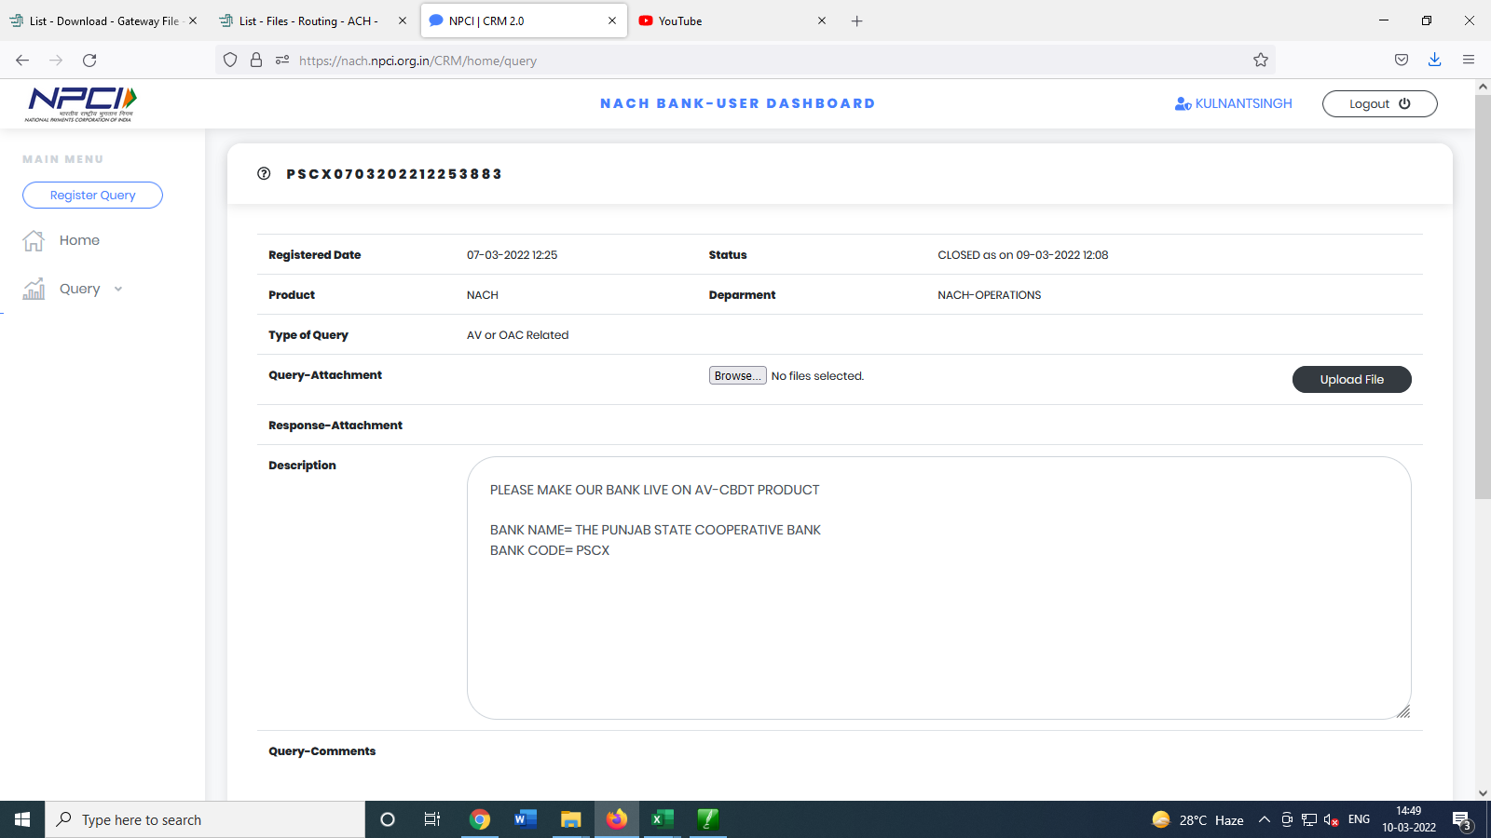
CRM

Slide 4
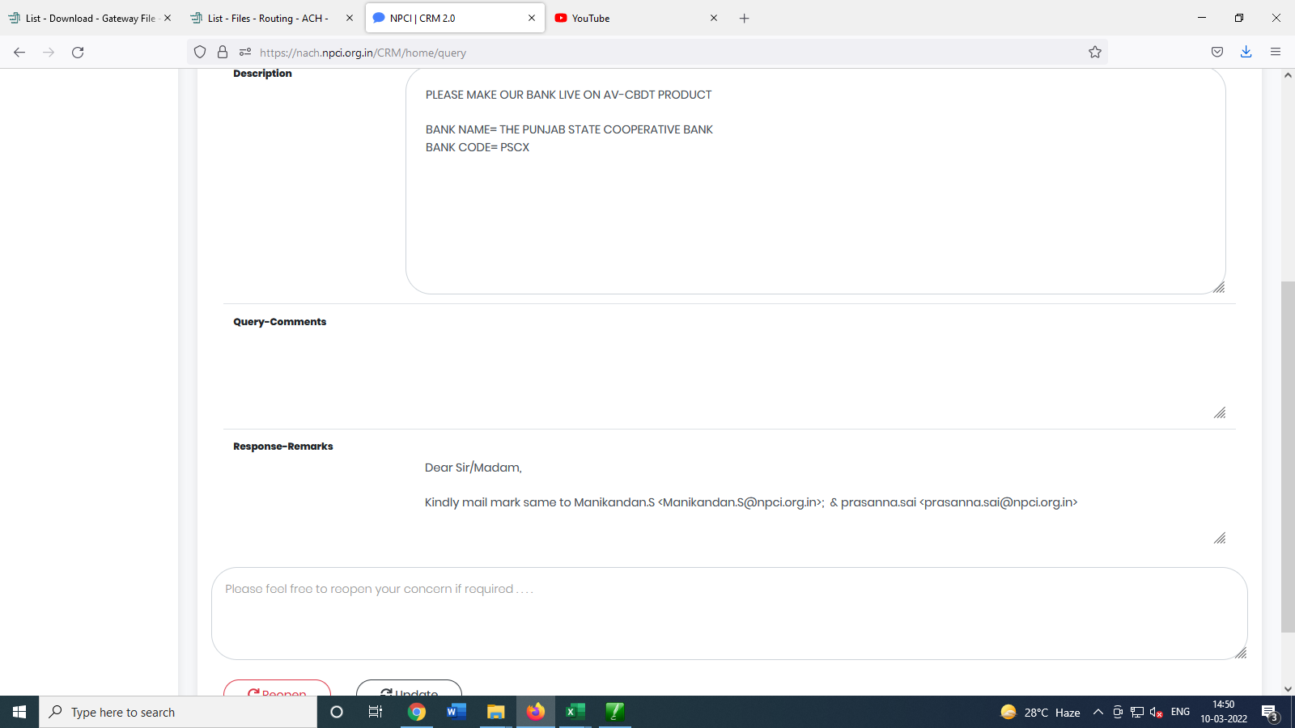
CRM

Slide 5
Install Python
Go to https://www.python.org/downloads/
Follow the steps to install python
Select default options

Slide 6
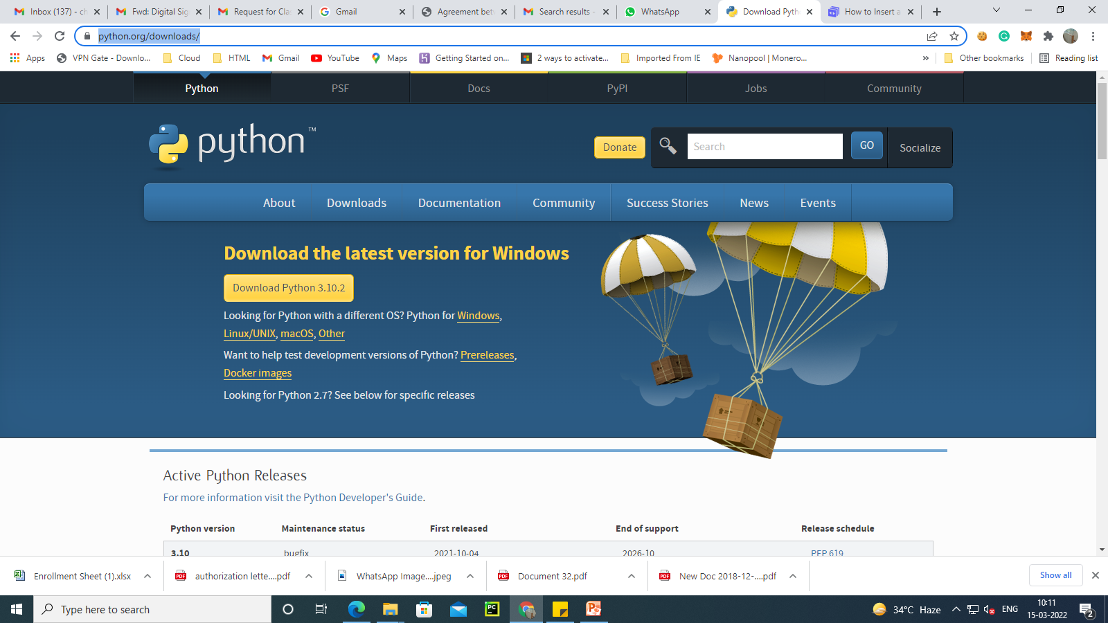
Click Here

Slide 7
Install pip and project files
After installation of python run following command
py -m ensurepip –upgrade
Download CBDT tool from github
https://github.com/amitcharaya/CBDTWEB
Click on download zip

Slide 8
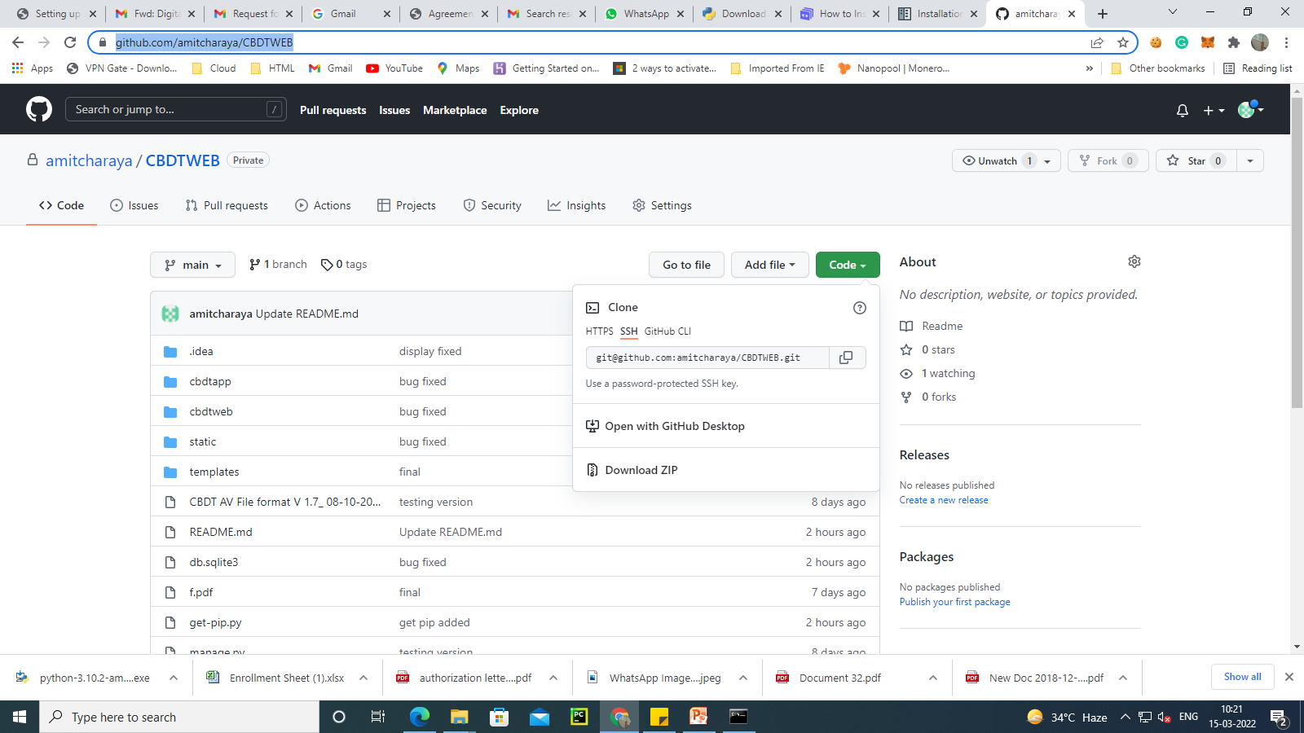

Slide 9
Rename Folder
Extract the zip folder
And rename the folders to CBDTWEB
Press windows +r command
Type cmd and open command prompt
Change to folder CBDTWEB

Slide 10
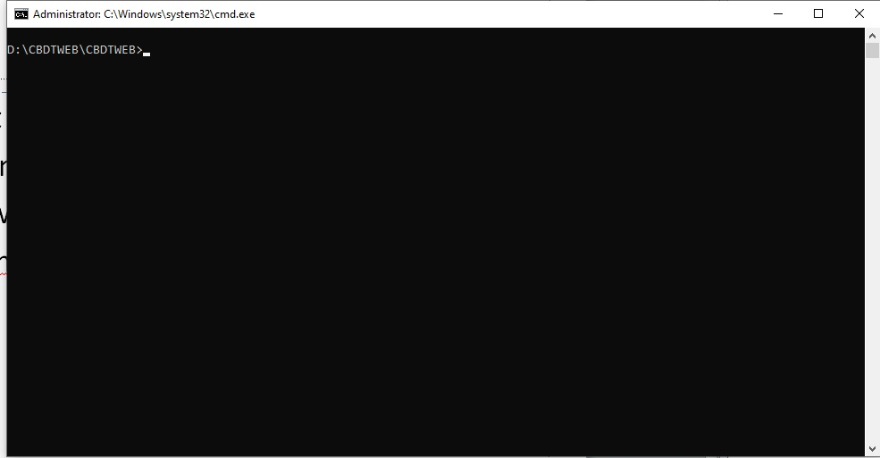
Command Prompt

Slide 11
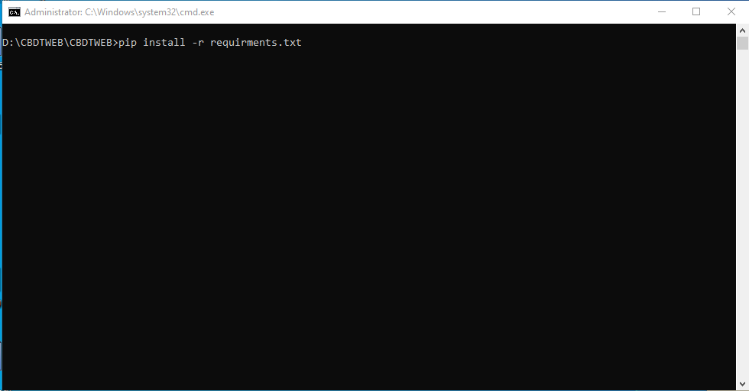
Run command pip install –r requirements.txt

Slide 12
Run following commands
Python manage.py makemigrations
Python manage.py migrate
Python manage.py createsuperuser
And create user by putting in info like:-
User name email id password
Python manage.py runserver

Slide 13
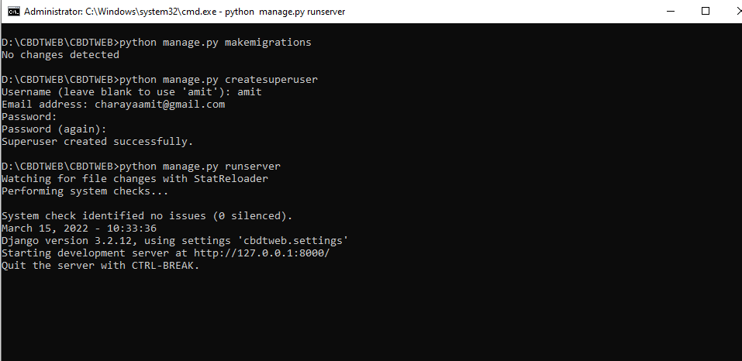
Run server

Slide 14
Go to URL
127.0.0.1:8000/admin
And create a user

Slide 15
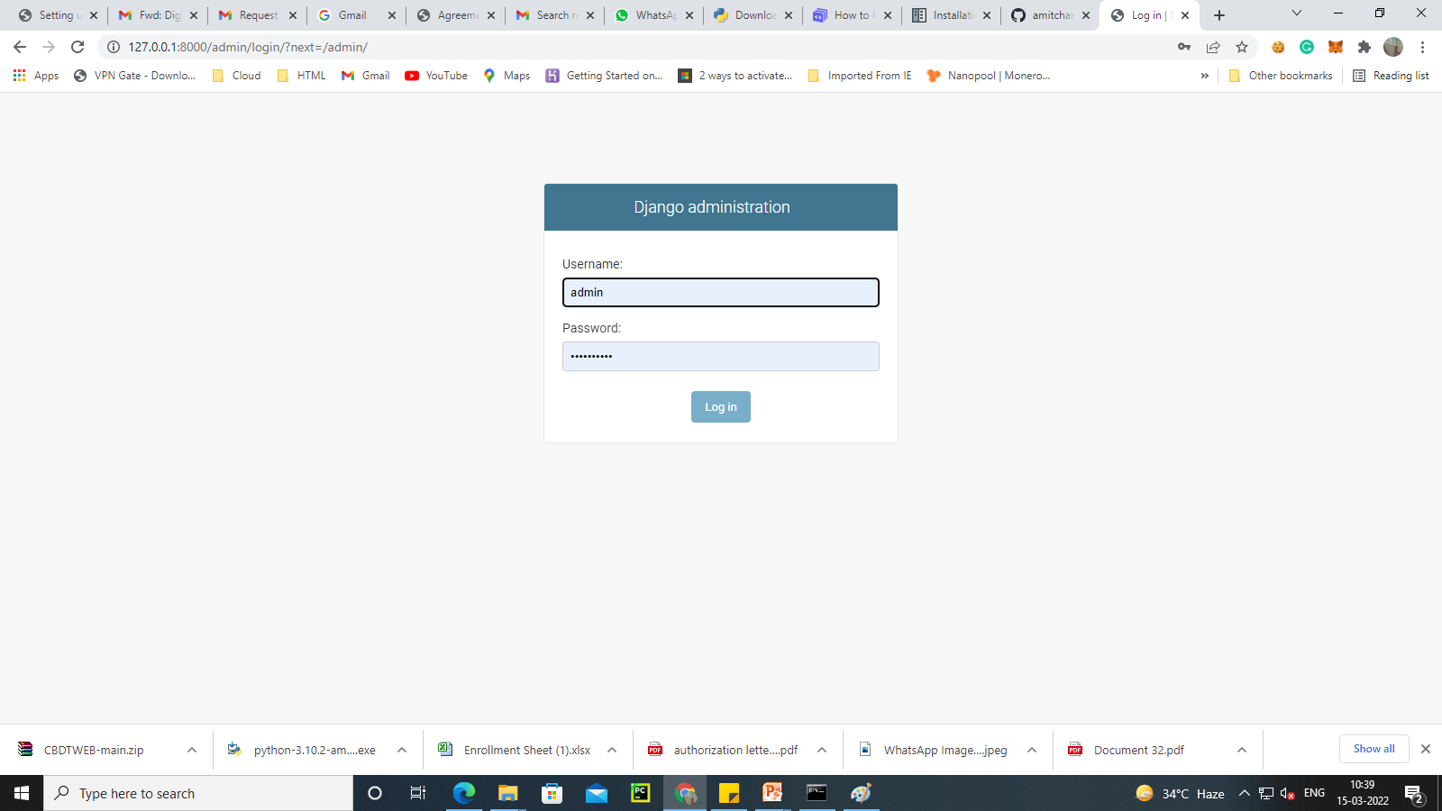

Slide 16
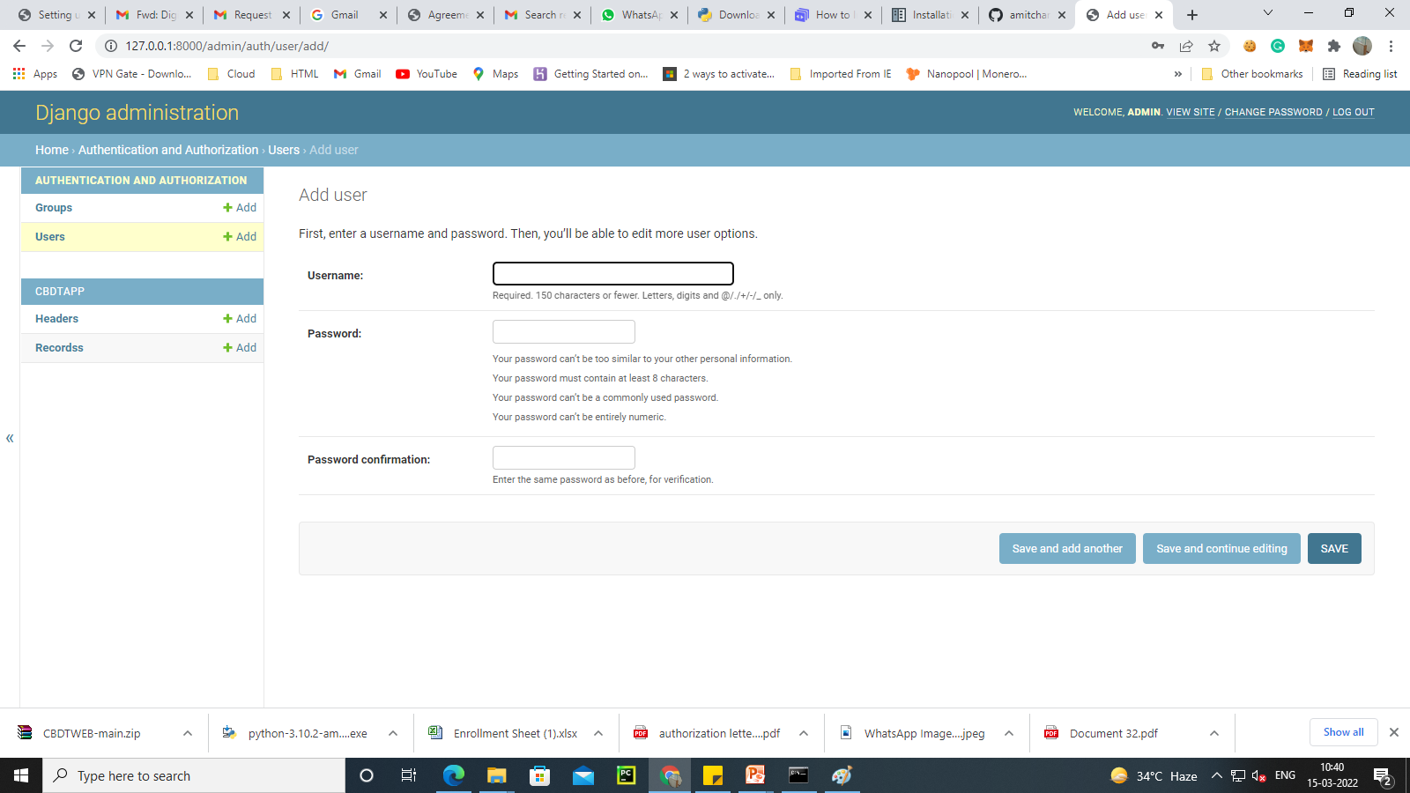
Add User
Log out

Slide 17
How to Access Application
Go to folder CBDTWEB
Run server using command
Python manage.py runserver
Go to URL 127.0.0.1:8000

Slide 18
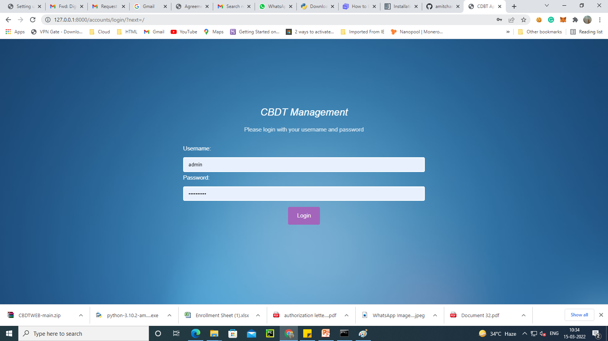

Slide 19
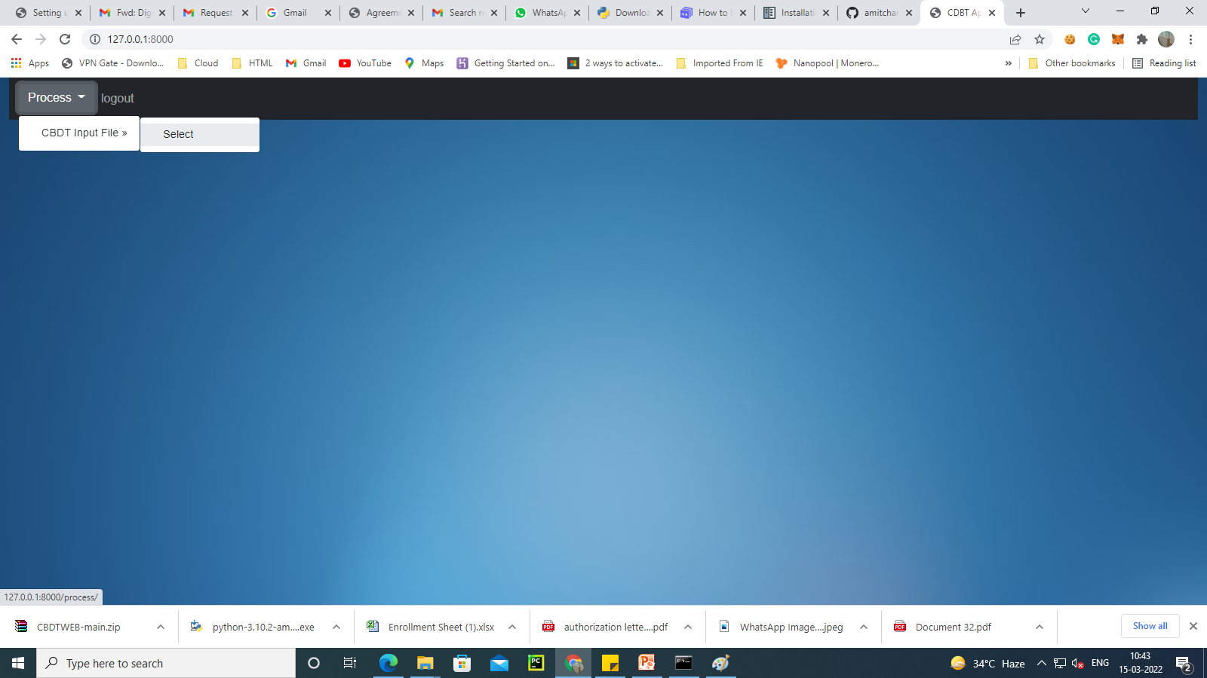

Slide 20
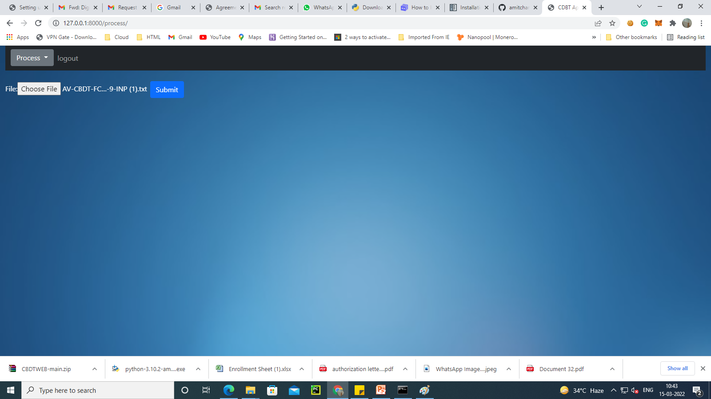

Slide 21
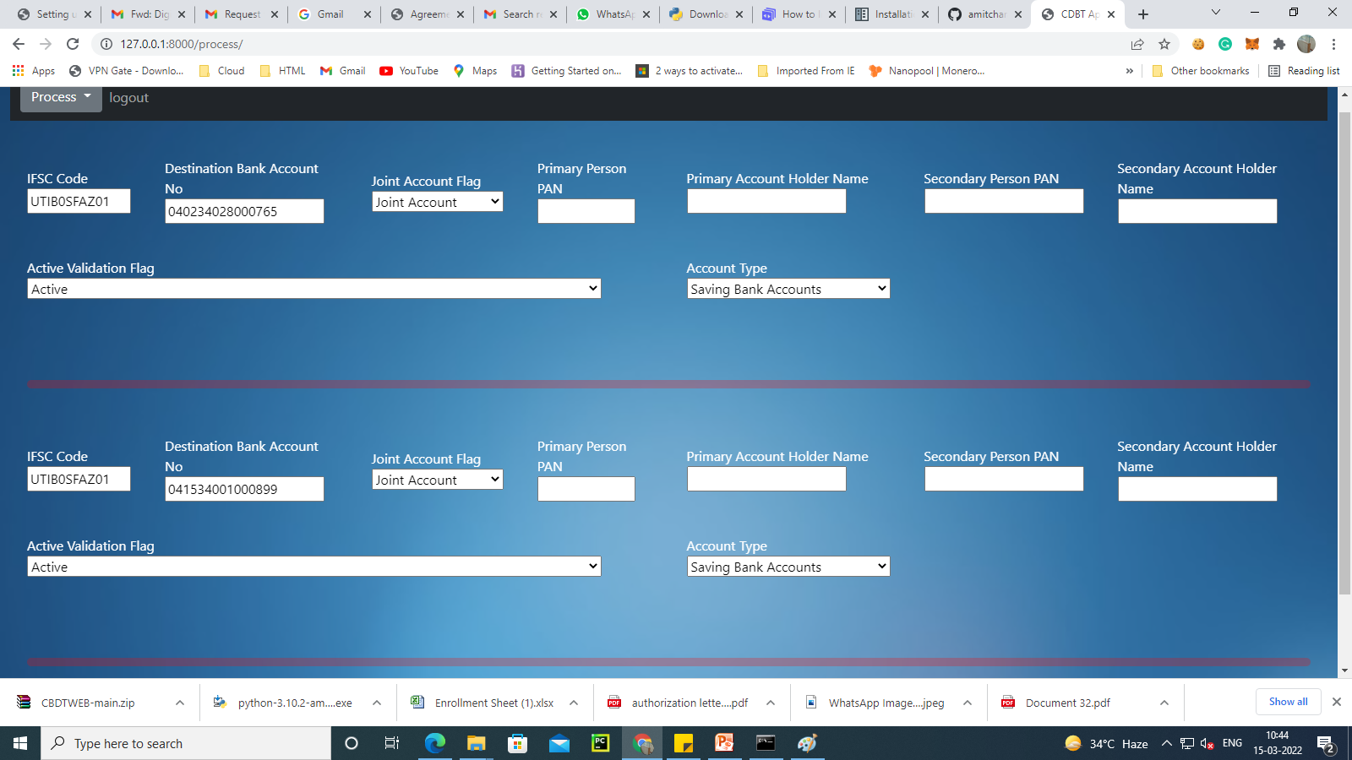
Fill in Required info

Slide 22
Click Submit
File will be created in
Static/outward folder
Logout after processing file and close the server by hitting CTRL+C
Sign the file and upload to NACH

Slide 23
Thank You

